Slide 1
Machine Learning
FACE RECOGNITION USING PRINCIPAL COMPONENT ANALYSIS AND LINEAR DISCRIMINANT ANALYSIS
Group 10

Slide 2
Introduction
What does the project aim to do?
Methodologies used:
PCA
LDA
Classification approach: kNN

Slide 3



Results: PCA
Training image
Mean face
Mean-shifted image

Slide 4
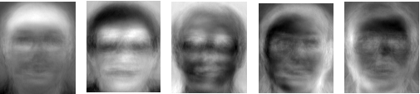
Results: PCA
Eigenfaces: 5 out of the 40 faces

Slide 5


Results: PCA
Test image
Matched image

Slide 6
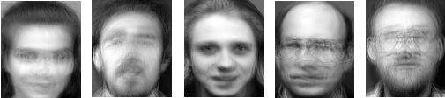
Results: LDA
Mean faces per class (individual): Samples shown below

Slide 7
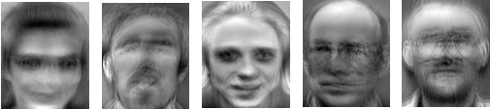
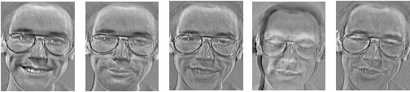
Results: LDA
Between-class Scatter:
Within-class Scatter:

Slide 8
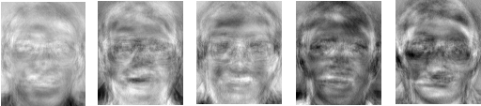
Results: LDA
Fisherfaces:

Slide 9


Results: LDA
Test image
Matched image

Slide 10
Results: PCA v. LDA
Speed Comparison (included database load times):
PCA:
LDA:
Test | 1 | 2 | 3 | 4 | 5 | 6 | 7 | 8 | 9 | 10
Speed (sec) | 20.39 | 19.80 | 20.35 | 20.23 | 19.96 | 19.63 | 20.32 | 20.47 | 19.97 | 20.46
Test | 1 | 2 | 3 | 4 | 5 | 6 | 7 | 8 | 9 | 10
Speed (sec) | 3.40 | 2.51 | 2.57 | 2.83 | 2.57 | 2.53 | 2.56 | 2.53 | 2.64 | 2.55

Slide 11
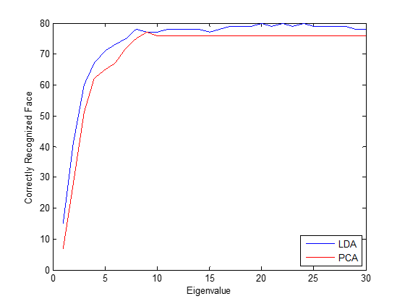
Results: PCA v. LDA
Accuracy Comparison

Slide 12

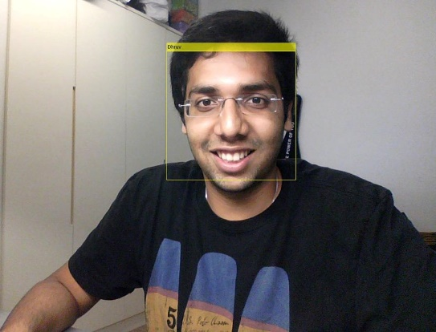

Webcam Project Demo
Expected Results:

